Slide 1

SUPERSTORE SALES ANALYSIS
By K G GOKUL

Slide 2
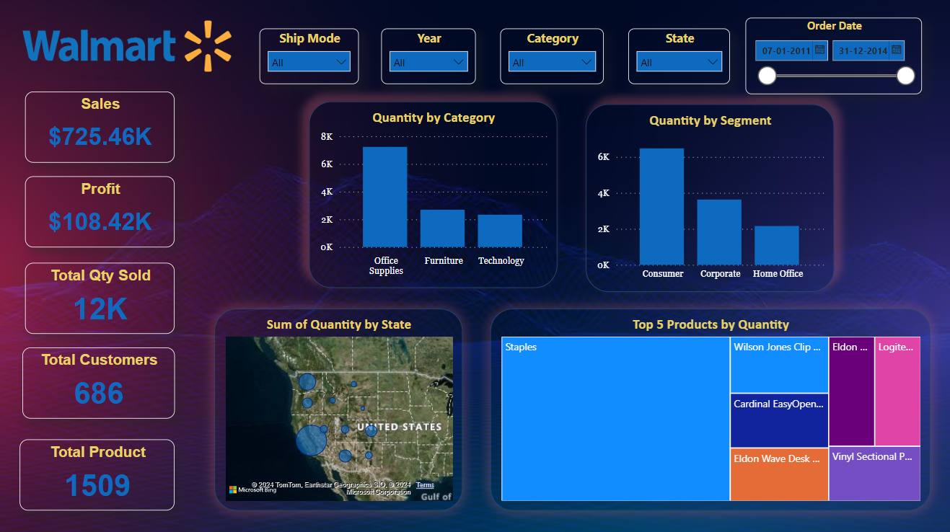
INVENTORY
2
In terms of quantity, Office Supplies led the way with a total of 7,235 units, followed by Furniture with 2,696 units, and Technology with 2,335 units.
The Consumer segment topped the quantity chart with 6,477 units, followed by the Corporate segment with 3,630 units, and the Home Office segment with 2,159 units.
Across all 11 State, California accounted for 62.51% of Sum of Quantity.

Slide 3
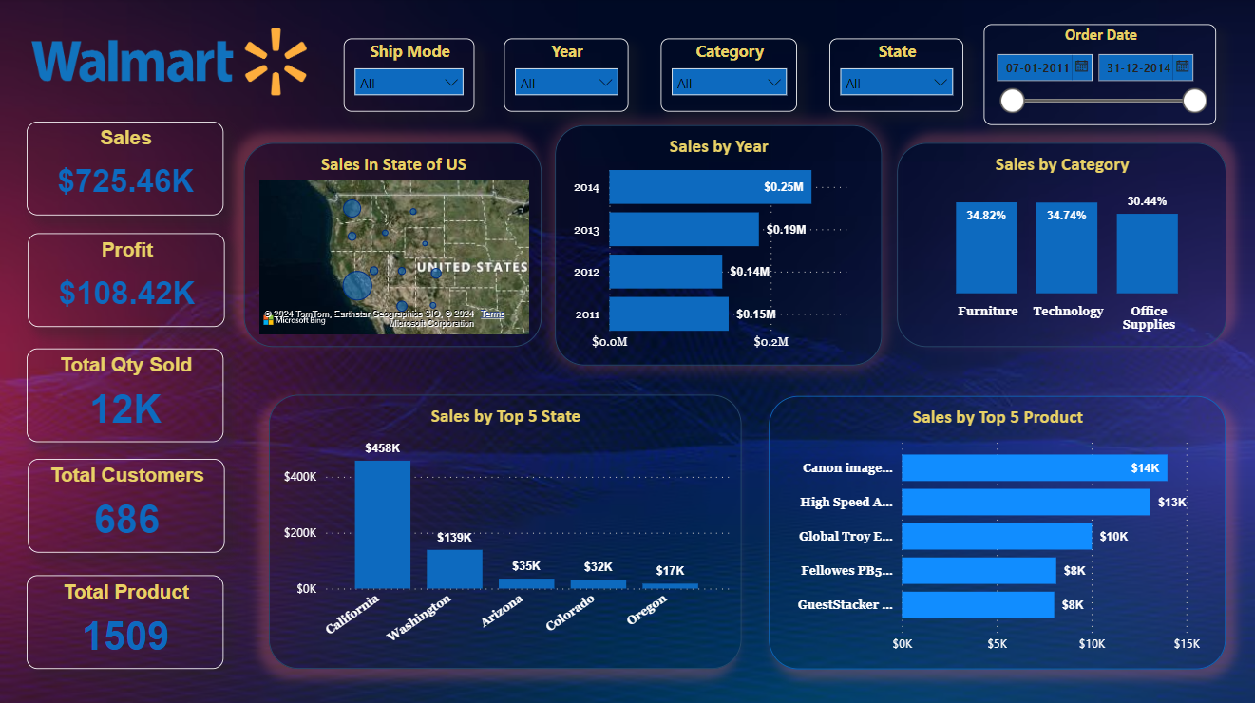
SALES
3
Throughout all 11 states California comprised 63.09% of the total sales sum.
Sum of Sales trended up, resulting in a 69.48% increase between 2011 and 2014.﻿﻿ Across all four years 2014 has grossed highest sales.
Among all the three categories, Furniture had a highest sales 34.82 % followed by Technology 34.74% and Office Supplies 30.44%.

Slide 4
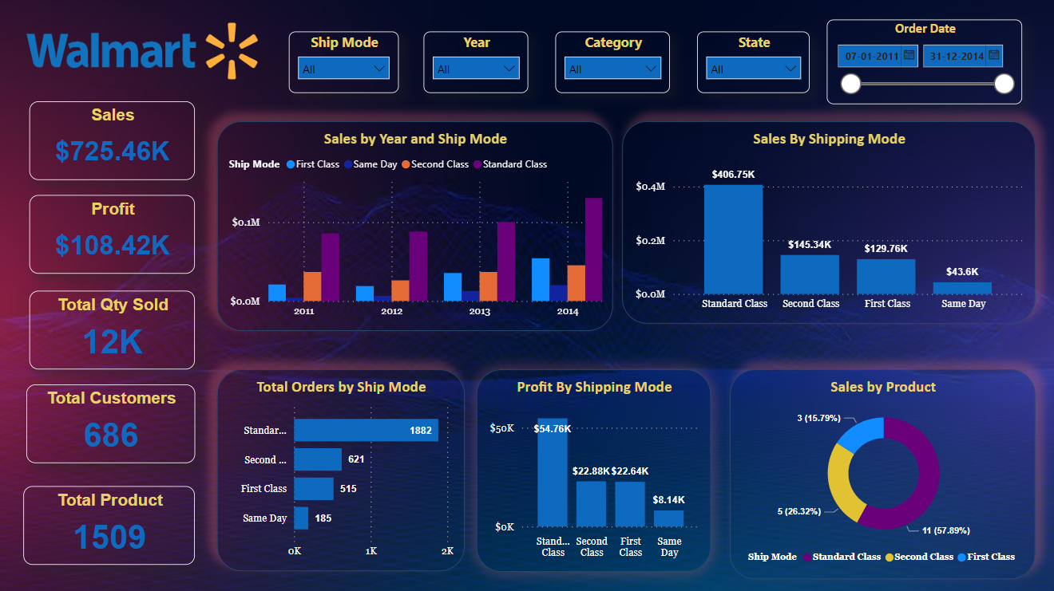
SHIPPING
4
Across Ship Mode, First Class had the most interesting recent trend and started trending up on 2011, rising by 158.98% in 3 years.﻿﻿
Standard Class ships the most orders and generates the most sales and profits, followed by Second Class, First Class, and Same Day.
The Sum of Profit for all four ship modes ranged from $8,141.9472 to $54,760.9657.

Slide 5
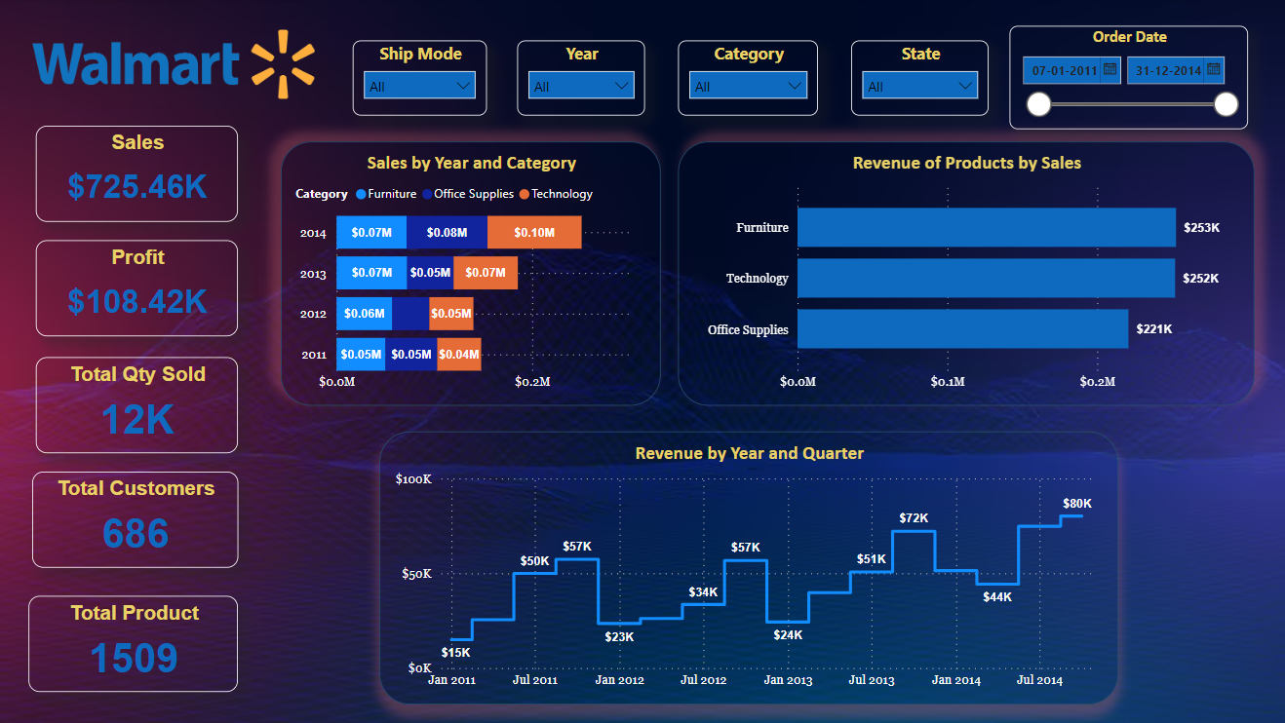
REVENUE
5
Technology was the category with the most intriguing recent development. It began to rise in 2011 and increased by 114.13% in just three years.﻿﻿
The highest revenue was recorded in 2014 and 2015, while the lowest revenue was recorded in 2012 and 2013.

Slide 6
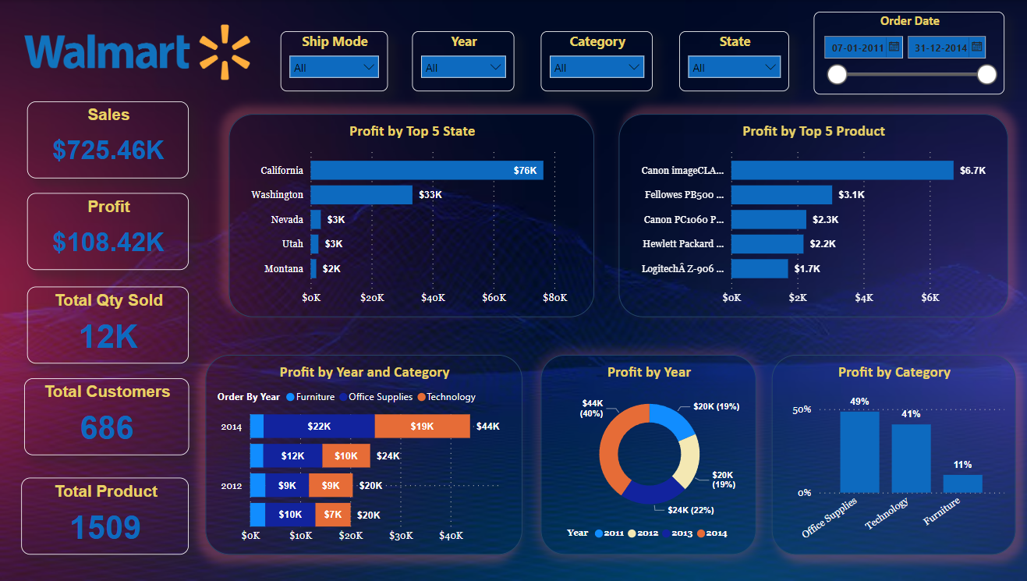
PROFIT
6
﻿Between 2011 and 2014, Office Supplies had the largest increase in Sum of Profit (122.47%) while Furniture had the largest decrease (11.69%).﻿﻿
California had the highest Sum of Profit with 65.02% which was 4,066.27% higher than Montana, which had the lowest Sum of Profit.
2014 has the highest profit margin of the four years at 40.49%.

Slide 7
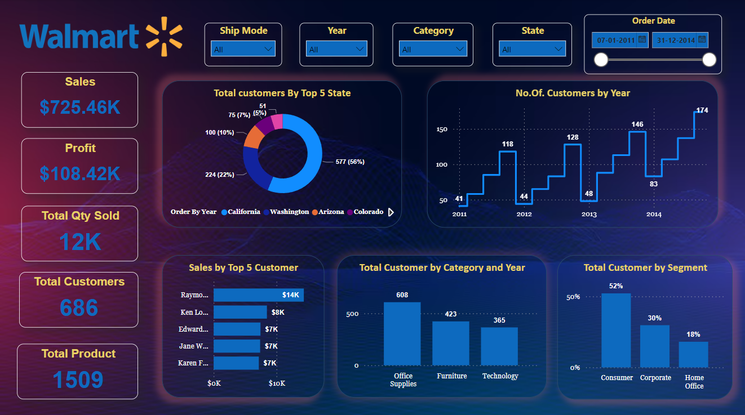
CUSTOMER
7
﻿﻿Count of Customers jumped from 128 to 174 during its steepest incline between October 2012 and October 2014.
Customers trended up, resulting in a 324.39% increase between January 2011 and October 2014.
﻿Office Supplies had the highest Count of Customers at 608, followed by Furniture at 423 and Technology at 365.

Slide 8
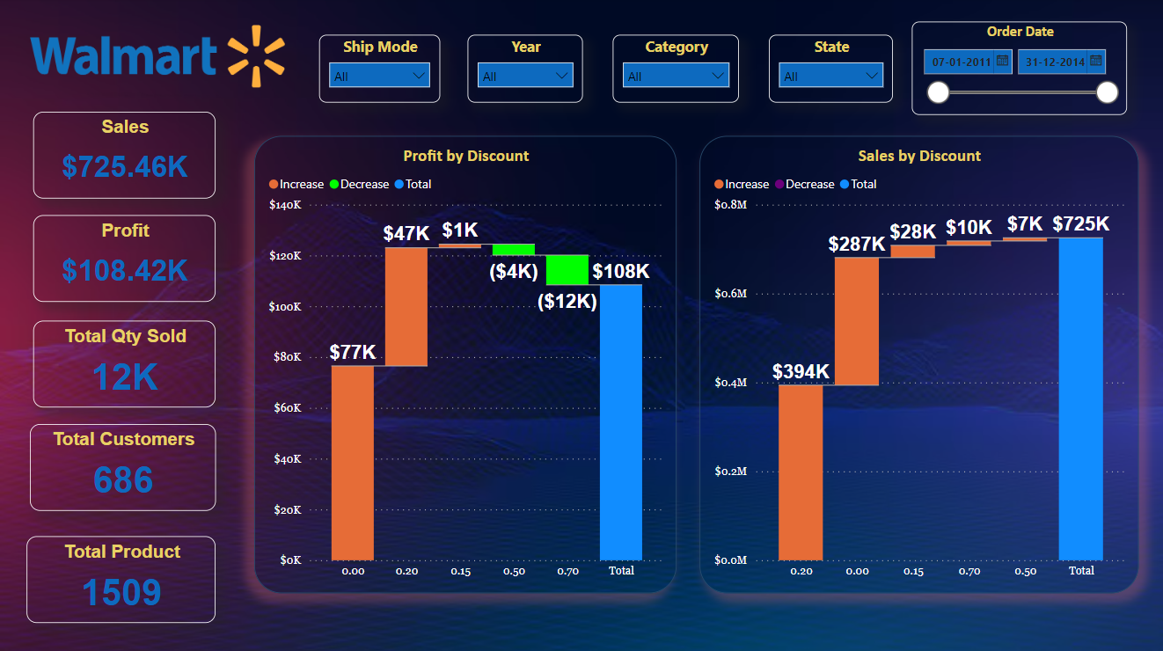
DISCOUNT
8
Offering a 0.2% discount on every purchase resulted in a record-breaking $725K in total sales, up $397K.
Discount was a significant factor in the $77K to $108K profit rise.

Slide 9
ROOT CAUSE
9
Overall, this analysis contains 11 states of US with three categories of products which is Furniture, Technology and Office Supplies.
2014 had the highest sales and profit of the four years, which is encouraging and suggests that there will be more sales in the years to come.
Over the course of four years, our total customer base has consisted of 52% consumers, 30% corporate, and 18% home office.

Slide 10
THANK YOU
K G GOKUL
Batch Code: MBM6

